Slide 1




Predicting outcomes and scores for EPL

Slide 2

Meet Our Team
Manmeet Singh Chawla
Bhagyalakshmi Patchipalu
Ramontal Philemon L
Supervised by
Dr. Sean Mondesire, Ph.D.

Slide 3
Data life cycle
Discovery
Phase 1: Discovery
Phase 2: Data Preparation
Phase 3: Model Planning
Phase 4: Model Building
Phase 5: Communicate Results
Phase 6: Operationalize
Operationalize
Data Preparation
Communicate Results
Model Planning
Model Building

Slide 4
Contents
Problem Statement
Data collection
Design and Implementation
Dependent Variables
Independent Variables
Model/Approach
Analysis
Results
References

Slide 5
Problem Statement:
Predicting the football match outcomes and scores for English Premier League
To develop a model for predicting the outcomes and scores in English Premier League (EPL) by using Data Mining and Machine learning techniques.
By using these approaches the most optimal model will be able to provide relative accuracy.

Slide 6
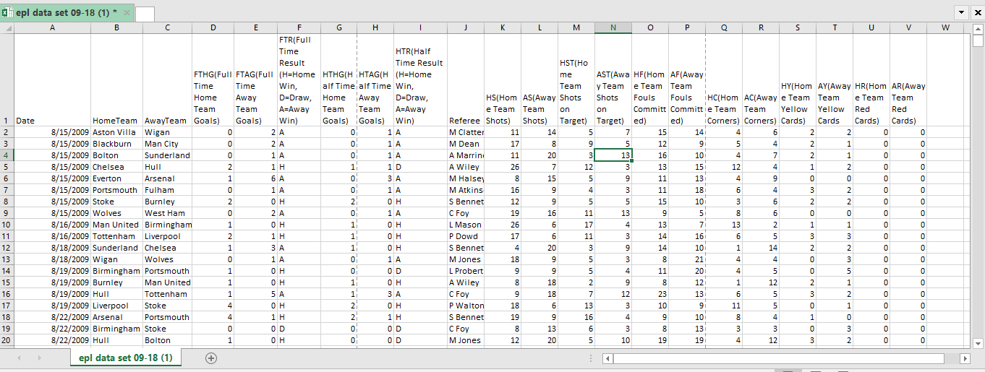
Data Collection:
The data is collected from 2009-2018 to predict the results and scores for English Premier League matches.

Slide 7
Design and Implementation:
To predict match outcomes and scores the model used: Data Mining Approach for predicting scores. Machining Learning approach is being used for predicting results with higher accuracy than other model approaches.
Data Mining techniques: Logistic Regression(LR), Decision Tree Classification, Support Vector Machine(SVM)
Machine Learning technique: Artificial Neural Network(ANN)
To Implement the design, R language was used to create the model.
Computer languages: R Studio 1.1.463
Libraries: readr (for reading the csv file), (e1071) (SVM), kernlab (assist with SVM feature selection), tidyverse (Data Visualization), h2o (For neural networks), caTools, rpart (decision trees).

Slide 8
Dependent Variables:
Full Time Results (FTR)
Description: It represents Win//Loss/Draw
Full Time Home team Goal (FTHG)
Description: No. of goal scored by the Home team.
Full Time Away team Goal (FTAG)
Description: No. of goal scored by the Away team

Slide 9
Independent Variables
Home Team Shots on Target (HST)
Description: Shot taken by home team within the target area.
Away Team Shots on Target (AST)
Description: Shot taken by away team within the target area.
Home Team Fouls (HF)
Description: Home team is aggressive defensively
Away Team Fouls (AF)
Description: Away team is aggressive defensively
Home Team Corners (HC)
Description: Corners kicks taken by Home team
Away Team Corners (AC)
Description: Corners kicks taken by Away team

Slide 10
Model/Approach:
For Predicting results four models were used, they include Logistic Regression, Decision Tree Classification, Support Vector Machine and Artificial Neural Network(ANN) however, the most optimal model was proven to be Artificial Neural Network (ANN).
For predicting Home and Away team scores, Multiple Linear Regression model was the optimal choice.

Slide 11
Training set:
Data set is split in to 80% to create the training set i.e (800 rows of 19 variables), because subsample random selections of the training data, train the classifier and record the performance on the validation set.
Testing set:
Data set is split in to 20% to create the testing set i.e (201 rows of 19 variables), because the models performance statistic will have greater variance.

Slide 12
Analysis: Decision Tree Classification
#Decision Tree Classification for predicting the result.
#install.packages("rpart")
library(rpart)
d <- rpart(formula=FTR~HST+AST+HF+AF, data=training_set)
d_pred<- predict(d,newdata = test_set[-4],type="class")
cm<- table(d_pred,test_set$FTR)
cm

Slide 13
Analysis: Logistic regression
# Logistic regression to find out the winner.
classfier <- glm(formula =result~HST+AST+HC+AC,family = "binomial" ,data= training_set)
prob_pred <- predict(classfier,type = 'response',newdata = test_set[-19])
y_pred <- ifelse(prob_pred<0.50,"A",ifelse(prob_pred<0.55,"D","H"))
cm<- table(y_pred,test_set$result)
cm

Slide 14
Analysis: Support Vector Machine (SVM)
# SVM for predicting the results.
# installing Kernlab for SVM
installed.packages("kernlab")
library(kernlab)
c <- svm(formula=FTR~HST+AST+HF+AF+HC+AC, data=training_set, type="C-classification",kernel= "radial")
s_pred<- predict(c,newdata = test_set[-4])
s_pred
cm<- table(s_pred,test_set$FTR)
cm

Slide 15
Analysis: Artificial Neural Network (ANN)
ANN <- h2o.deeplearning(y = "result",
training_frame = as.h2o(training_set),
activation = "Rectifier",
hidden =c(8),
epochs = 100,
train_samples_per_iteration = -2) neural.pred <- h2o.predict(ANN, newdata = as.h2o(test_set[-15]))
network.pred <- ifelse(neural.pred<0.33,"A",ifelse(neural.pred<0.66,"D","H"))
network.pred <- as.vector(network.pred)

Slide 16
Analysis: Multiple Linear Regression
# Pridicting the Home team goals.
hg<- lm(formula =FTHG~HST+HC+AST+HF+AC, data = training_set)
summary(hg)
hg_pred<- predict(hg,newdata = test_set[-5])
hg_pred
round(hg_pred)

Slide 17
Analysis: Multiple Linear Regression
# predicting the Away team goals.
ag<- lm(formula =FTAG~AST+AC, data = training_set)
summary(ag)
ag_pred<- predict(hg,newdata = test_set[-6])
ag_pred
round(ag_pred)

Slide 18
Results:
The ANN model was able to predict the outcome with 98% accuracy.
Logistic Regression | Decision Tree Classification | Support Vector Machine | Artificial Neural Network
64.17% | 61.69% | 63.68% | 98%

Slide 19
References:
Nivard van Wijk. (December 2012). Soccer Analytics Predicting the outcome of soccer matches.
Retrieved from
https://beta.vu.nl/nl/Images/werkstuk-wijk_tcm235-315158.pdf
Aditya Srinivas Timmaraju. Game ON! Predicting English Premier League Match Outcomes
Retrieved from
http://cs229.stanford.edu/proj2013/TimmarajuPalnitkarKhannaGameON!PredictionOf EPLMatchOutcomes.pdf
Francisco Louzada. (2014). “Predicting Match Outcomes in the English Premier League: Which Will Be the Final Rank?”
Retrieved from
https://www.coursehero.com/file/32926170/2JDS-1157-3pdf

Slide 20
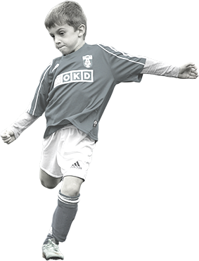

Thank you

Slide 21


